Slide 1




PDS
Previous Class Test Diagram
Computer Vision
https://github.com/siagianp
https://www.youtube.com/@AmelOline/videos
https://github.com/amelcharolinesgn2/Cloud-Infrastructures
https://github.com/amelcharolinesgn2/ClouD-Infrastructure-SISKA-2025
https://github.com/amelcharolinesgn2/CCNA1
https://github.com/amelcharolinesgn2/CCNA2
https://github.com/amelcharolinesgn2/AWS Certificate
Notes:
Lab Session 01: AWS Compute Foundations – EC2, Networking, and Application Deployment Lab Session 02: Identity and Access Control with IAM Lab Session 03: Cloud Storage Solutions – S3, EBS, and EFS Lab Session 04: Database Services – RDS, DynamoDB, and ElastiCache Lab Session 05: Load Balancing and Auto Scaling Lab Session 06: Container Orchestration with ECS, Fargate, and EKS Lab Session 07: Serverless Computing with Lambda Lab Session 08: Monitoring, Logging, and Security Auditing Lab Session 09: Infrastructure as Code – CloudFormation, CDK, and Terraform Lab Session 10: CI/CD Pipelines – App Runner, CodePipeline, GitHub Actions, and CodeDeploy Lab Session 11: AI/ML Services – Rekognition, Comprehend, Translate, and SageMaker Lab Session 12: Hybrid Cloud Networking – VPC Peering, Transit Gateway, VPN, and Direct Connect Lab Session 13: Security and Compliance – AWS Config, GuardDuty, Security Hub, and KMS Lab Session 14: Disaster Recovery and Business Continuity – AWS Backup, Multi-Region, and Failover Lab Session 15: Migration and Modernization – DataSync, DMS, MGN, Containers, and Serverless
Lab Session 16: Cost Management and Optimization – Cost Explorer, Trusted Advisor, Budgets, and Well-Architected
https://www.youtube.com/watch?v=SOTamWNgDKc&t=19604s

Slide 2
Previous Class Test Diagram

Slide 3
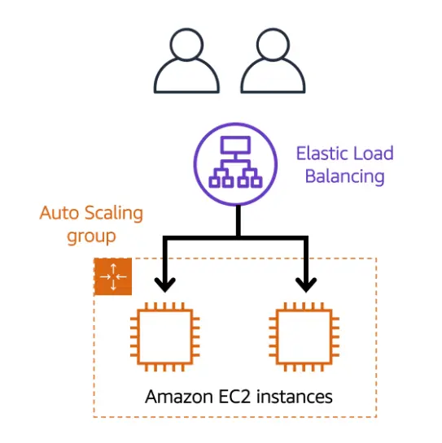
Auto Scaling

Slide 4
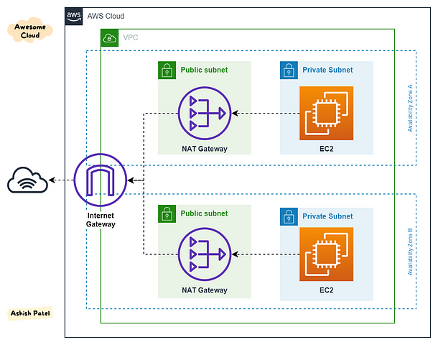
VPC

Slide 5
Virtualization: Future of Computing
A deep dive into the concepts, types, and applications of virtualization.

Slide 6
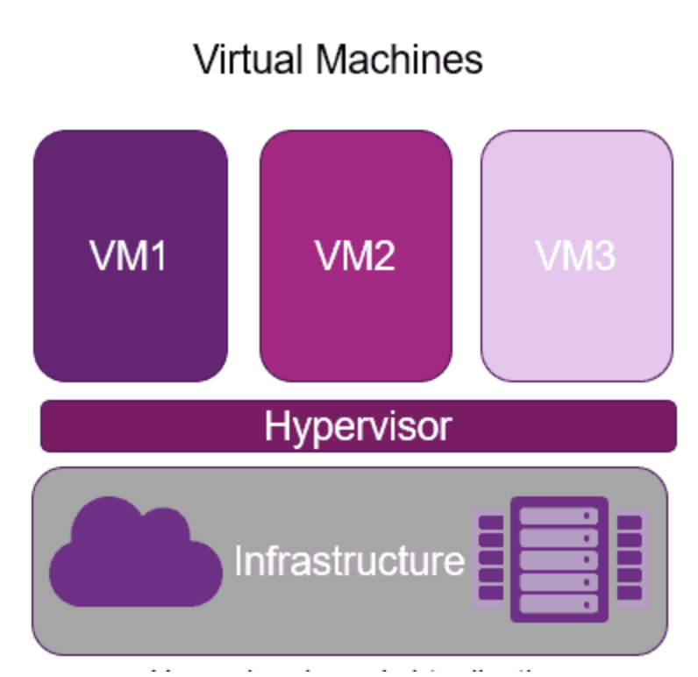
Introduction to Virtualization
Virtualization is the process of creating a virtual version of computing resources such as servers, storage devices, networks, or even operating systems.
Key Benefits:
Improved resource utilization.
Reduced IT costs.
Enhanced flexibility and scalability.

Slide 7
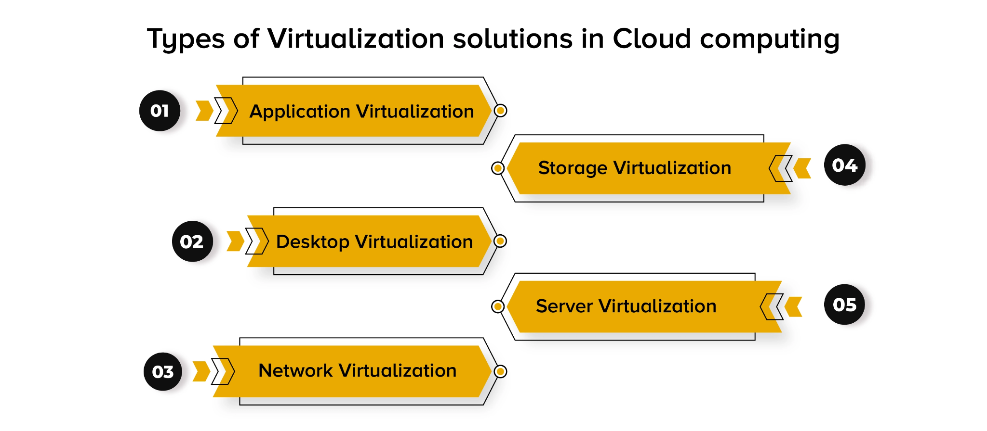

Slide 8
Types of Virtualization
1. Server Virtualization: Partitioning a physical server into multiple virtual servers.
2. Desktop Virtualization: Allows users to access desktops remotely.
3. Network Virtualization: Combines hardware and software network resources into a single, software-based entity.
4. Storage Virtualization: Pools physical storage resources into a single virtual resource.

Slide 9
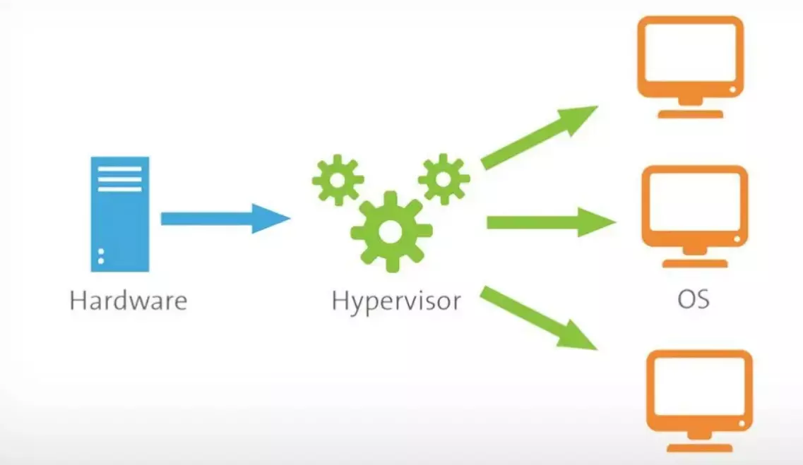
What is Hypervisor?
A hypervisor, also known as a virtual machine monitor (VMM) or virtualizer, is a type of computer software, firmware or hardware that creates and runs virtual machines.

Slide 10
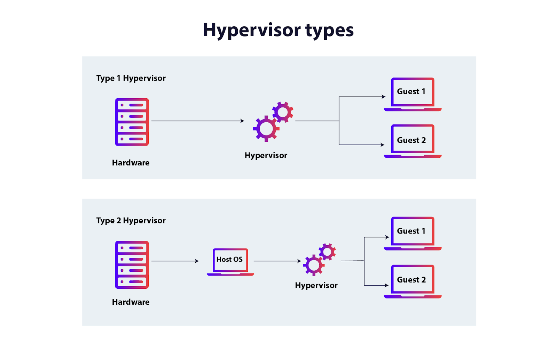

Slide 11
How Virtualization Works
Core Components:
Hypervisor: Software that creates and manages virtual machines (VMs).
Guest OS: The operating system running inside the VM.
Host OS: The operating system managing the physical hardware.
Types of Hypervisors:
Type 1: Runs directly on hardware (e.g., VMware ESXi).
Type 2: Runs on a host operating system (e.g., VirtualBox).

Slide 12
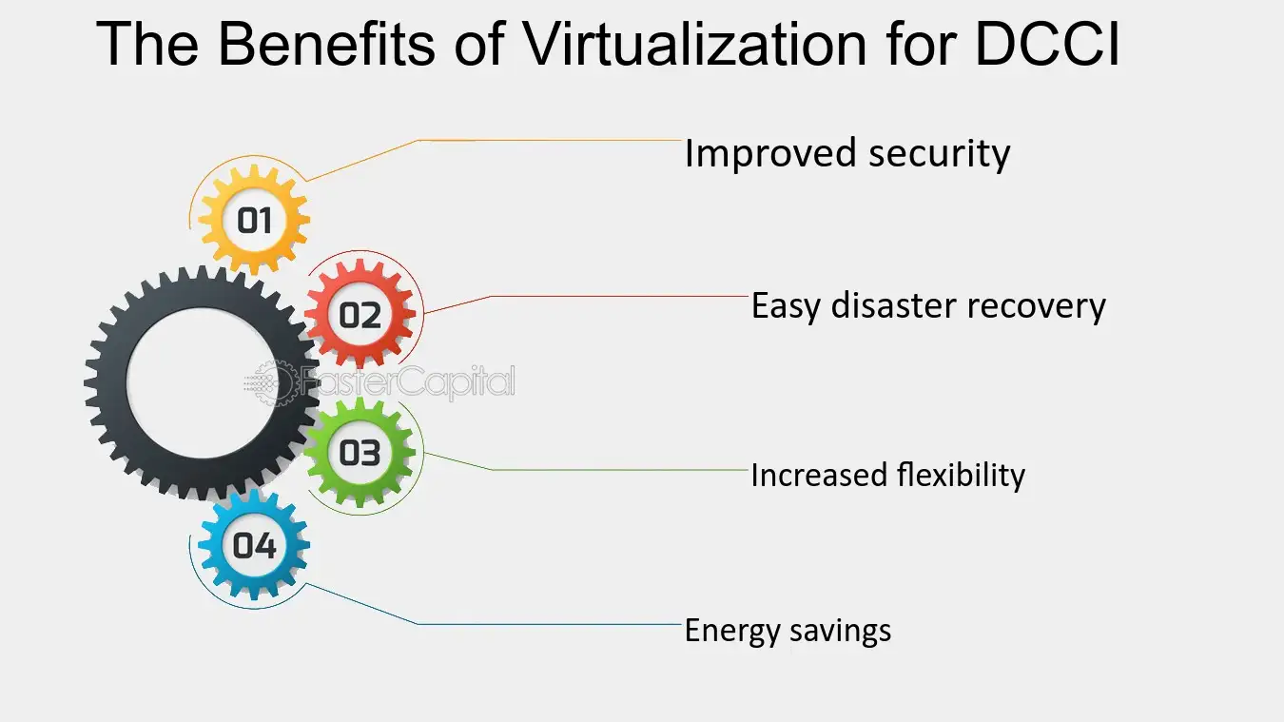
Advantages of Virtualization
Data Center Consolidation initiative
Cost Savings:
Lower hardware requirements.
Reduced energy consumption.
Flexibility:
Easy migration of workloads.
Scalability.
Improved Disaster Recovery:
Backups and snapshots.

Slide 13
Challenges of Virtualization
Initial Costs: Higher upfront costs for setup.
Complexity: Requires expertise for configuration and maintenance.
Performance Overhead: Potential decrease in performance due to resource sharing.
Security Concerns: Risks like VM escape and hypervisor attacks.

Slide 14
Applications of Virtualization
Cloud Computing: Foundation for services like IaaS, PaaS, and SaaS.
Development and Testing: Isolated environments for software development.
Disaster Recovery: Quick restoration of systems.
Education and Training: Virtual labs and simulations.

Slide 15
Future of Virtualization
Emerging Trends:
Containerization (e.g., Docker, Kubernetes).
Edge Computing.
Virtual Reality (VR) and Augmented Reality (AR).
Impact: Greater focus on scalability, speed, and efficiency.

Slide 16
Summary
Virtualization transforms IT infrastructure by optimizing resource utilization, reducing costs, and improving scalability.
Key types include server, storage, network, and desktop virtualization.
Challenges like security risks and complexity need to be managed effectively.

Slide 17
THANK YOU
Amel charoline
Amel Online & Irene magdalena
https://github.com/siagianp
https://www.youtube.com/@AmelOline/videos
https://github.com/amelcharolinesgn2/Cloud-Infrastructures
https://github.com/amelcharolinesgn2/ClouD-Infrastructure-SISKA-2025
https://github.com/amelcharolinesgn2/CCNA1
https://github.com/amelcharolinesgn2/CCNA2
https://github.com/amelcharolinesgn2/AWS Certificate

